Slide 1
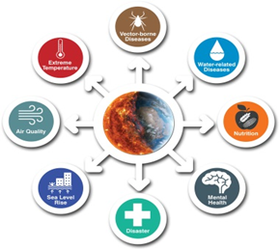

Connections of Downscaled Climate Information and Health Sector
U.S.-India Partnership for Climate Resilience
Workshop on Development and Applications of Downscaling Climate Projections
Meena Sehgal, Fellow, TERI

Slide 2
Presentation Outline
Understanding Climate and Health Associations in India (UCHAI) network- health community needs assessment
Climate risks for health in India
Health in the State Action Plans for Climate Change
Opportunities and challenges- workshop
Way forward for UCHAI

Slide 3
UCHAI network: Needs assessment for capacity building and gap identification
Notes:
Greatest concern – VBD, extreme weather and food & water borne diseases
Capacity building - Research on health impacts of CC, vulnerability assessment, building resilience of h system
Researchers; consultants; capacity building; policy advocacy; teaching

Slide 4
Notes:
Training extreme weather, Food & water borne
Skills – adaptation planning, use of climate forecasts, epidemiological studies

Slide 5
Andhra Pradesh: Malaria cases
2014
2015
2016
Number of reported cases
National Vector Borne Disease Control Programme: About 95% population in India resides in malaria endemic areas.
Around 5% of the total 214 million deaths across the globe due to malaria happen in India.
Smart Mosquito Density System: Vijayawada, Vishakhapatnam and Tirupati — want to use modern technology to detect mosquito breeding before malaria and other vector-borne diseases such as dengue, chikungunya and zika become an epidemic.
http://timesofindia.indiatimes.com/india/andhra-pradesh-plans-hi-tech-war-on-mosquitoes/articleshow/57438635.cms (accessed 04032017)
Data Source: Integrated Disease Surveillance Programme (IDSP)
Notes:
Reported malaria cases for the 13 districts of AP for the last 3 years.
A total of 1,850 sensors will be deployed across 185 sq kilometers of these cities Sensors fixed to electricity poles will be used to monitor density of mosquitoesalong with gender and species. The devices will analyse and transfer mosquito density data along with location to a central database. There will be a control room application to provide mosquito density heat maps, which will help government agencies prioritise sprays.
The system will operate autonomously and use state-of-the-art internet of things (IoT) technology to alert health and other agencies of the need to treat geographic areas to control the mosquito population responsible for vector-borne diseases.
3 districts bear the largest burden from this vector borne disease- East Godavari; Vizianagaram, Visakhapatnam.
A seasonal pattern can also be noted. A rise in reported cases begins from the 3rd month each year; followed by a peak during the summer months; and the cases dip down towards the year end. The weeks of relief are few or non existent in these 3 districts.
AP is along the West Coast. These 3 districts are coastal districts- vulnerable because of humidity/ precipitation and warm temperature. A targeted health action plan, protective strategy, and treatment measures are much needed. Health action plans guided by IMD forecasts, early warning systems and predict analysis could significantly assist the process.

Slide 6
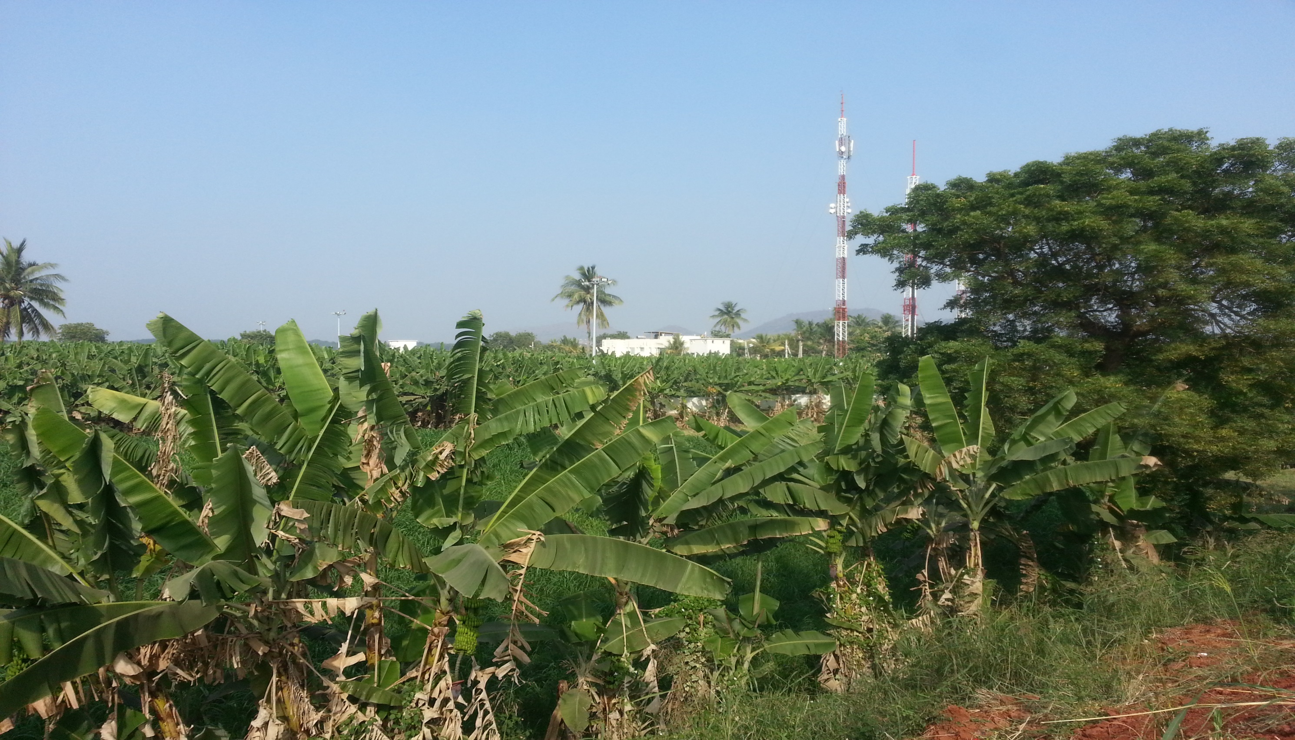
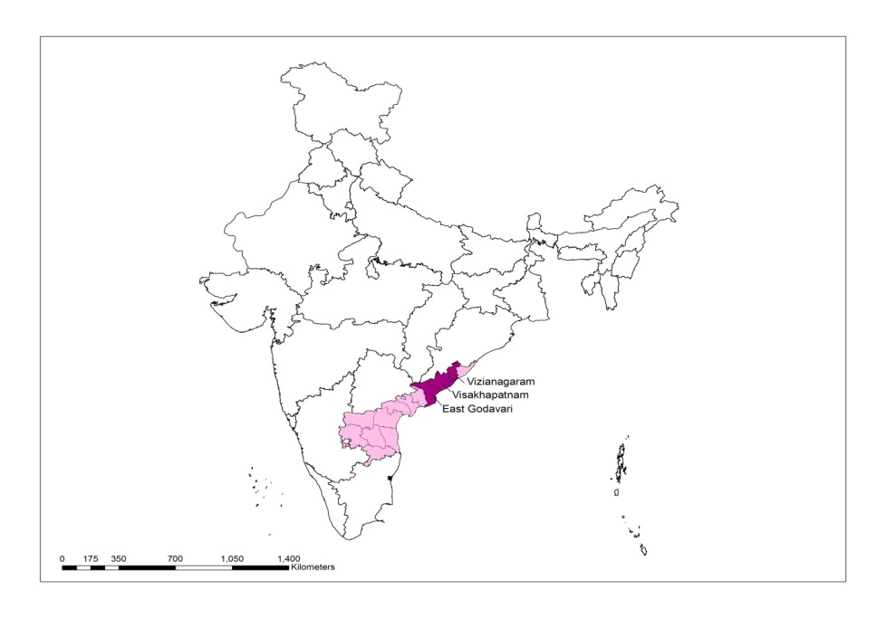
Andhra Pradesh: Malaria challenges- determinants
Andhra Pradesh

Slide 7
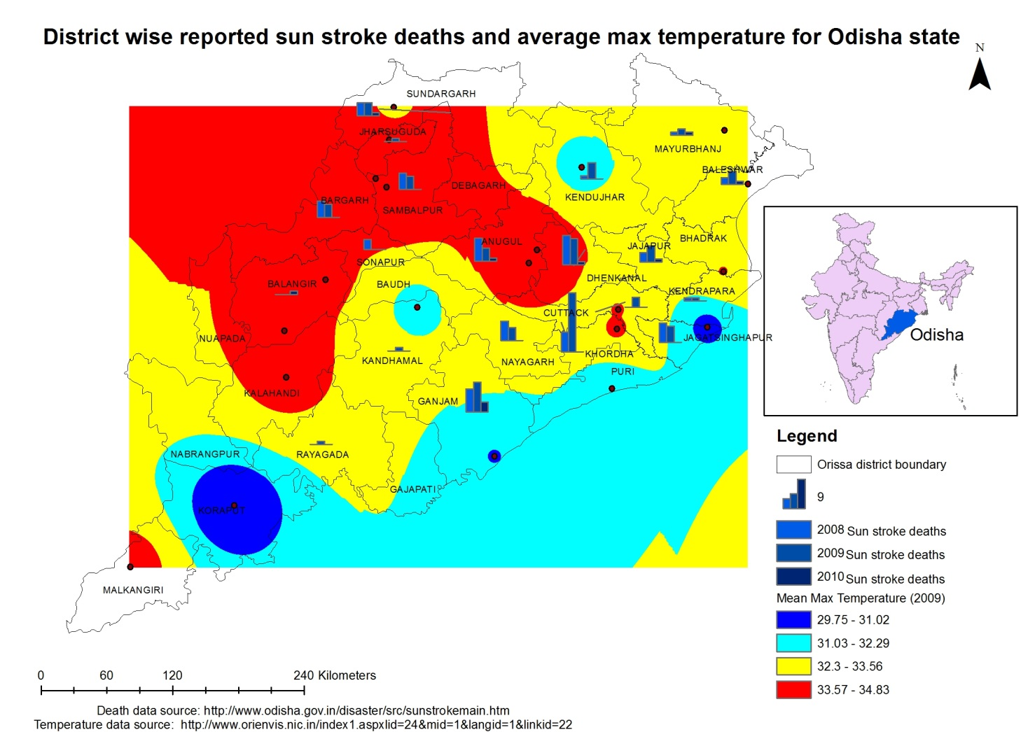
Notes:
Some populations are more vulnerable than others- the very young; the very old; the extremely poor.
The heat stress related mortality presented here is not segregate by these factors; it does not say who is dying and at what location.
But the data still states that the hottest districts do show significantly larger numbers of deaths.
Orissa heat action plans have included dissemination information for behaviour change; ongoing initiatives include developing - guidelines for health infrastructure and logistics; provision of medical services; early detection mechanism particularly for vulnerable population; information dissemination processes; community adaptation particularly for community exposed by occupation;
Future plans : determine thresholds of humidity and temperature for determining mortality and morbidity;

Slide 8
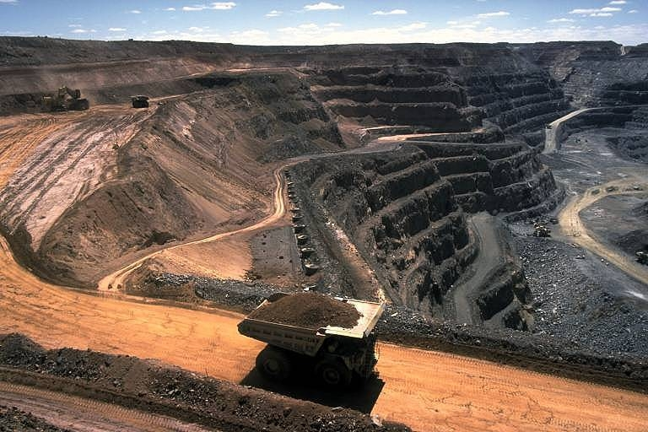
Determinants of health: access to health care

Slide 9
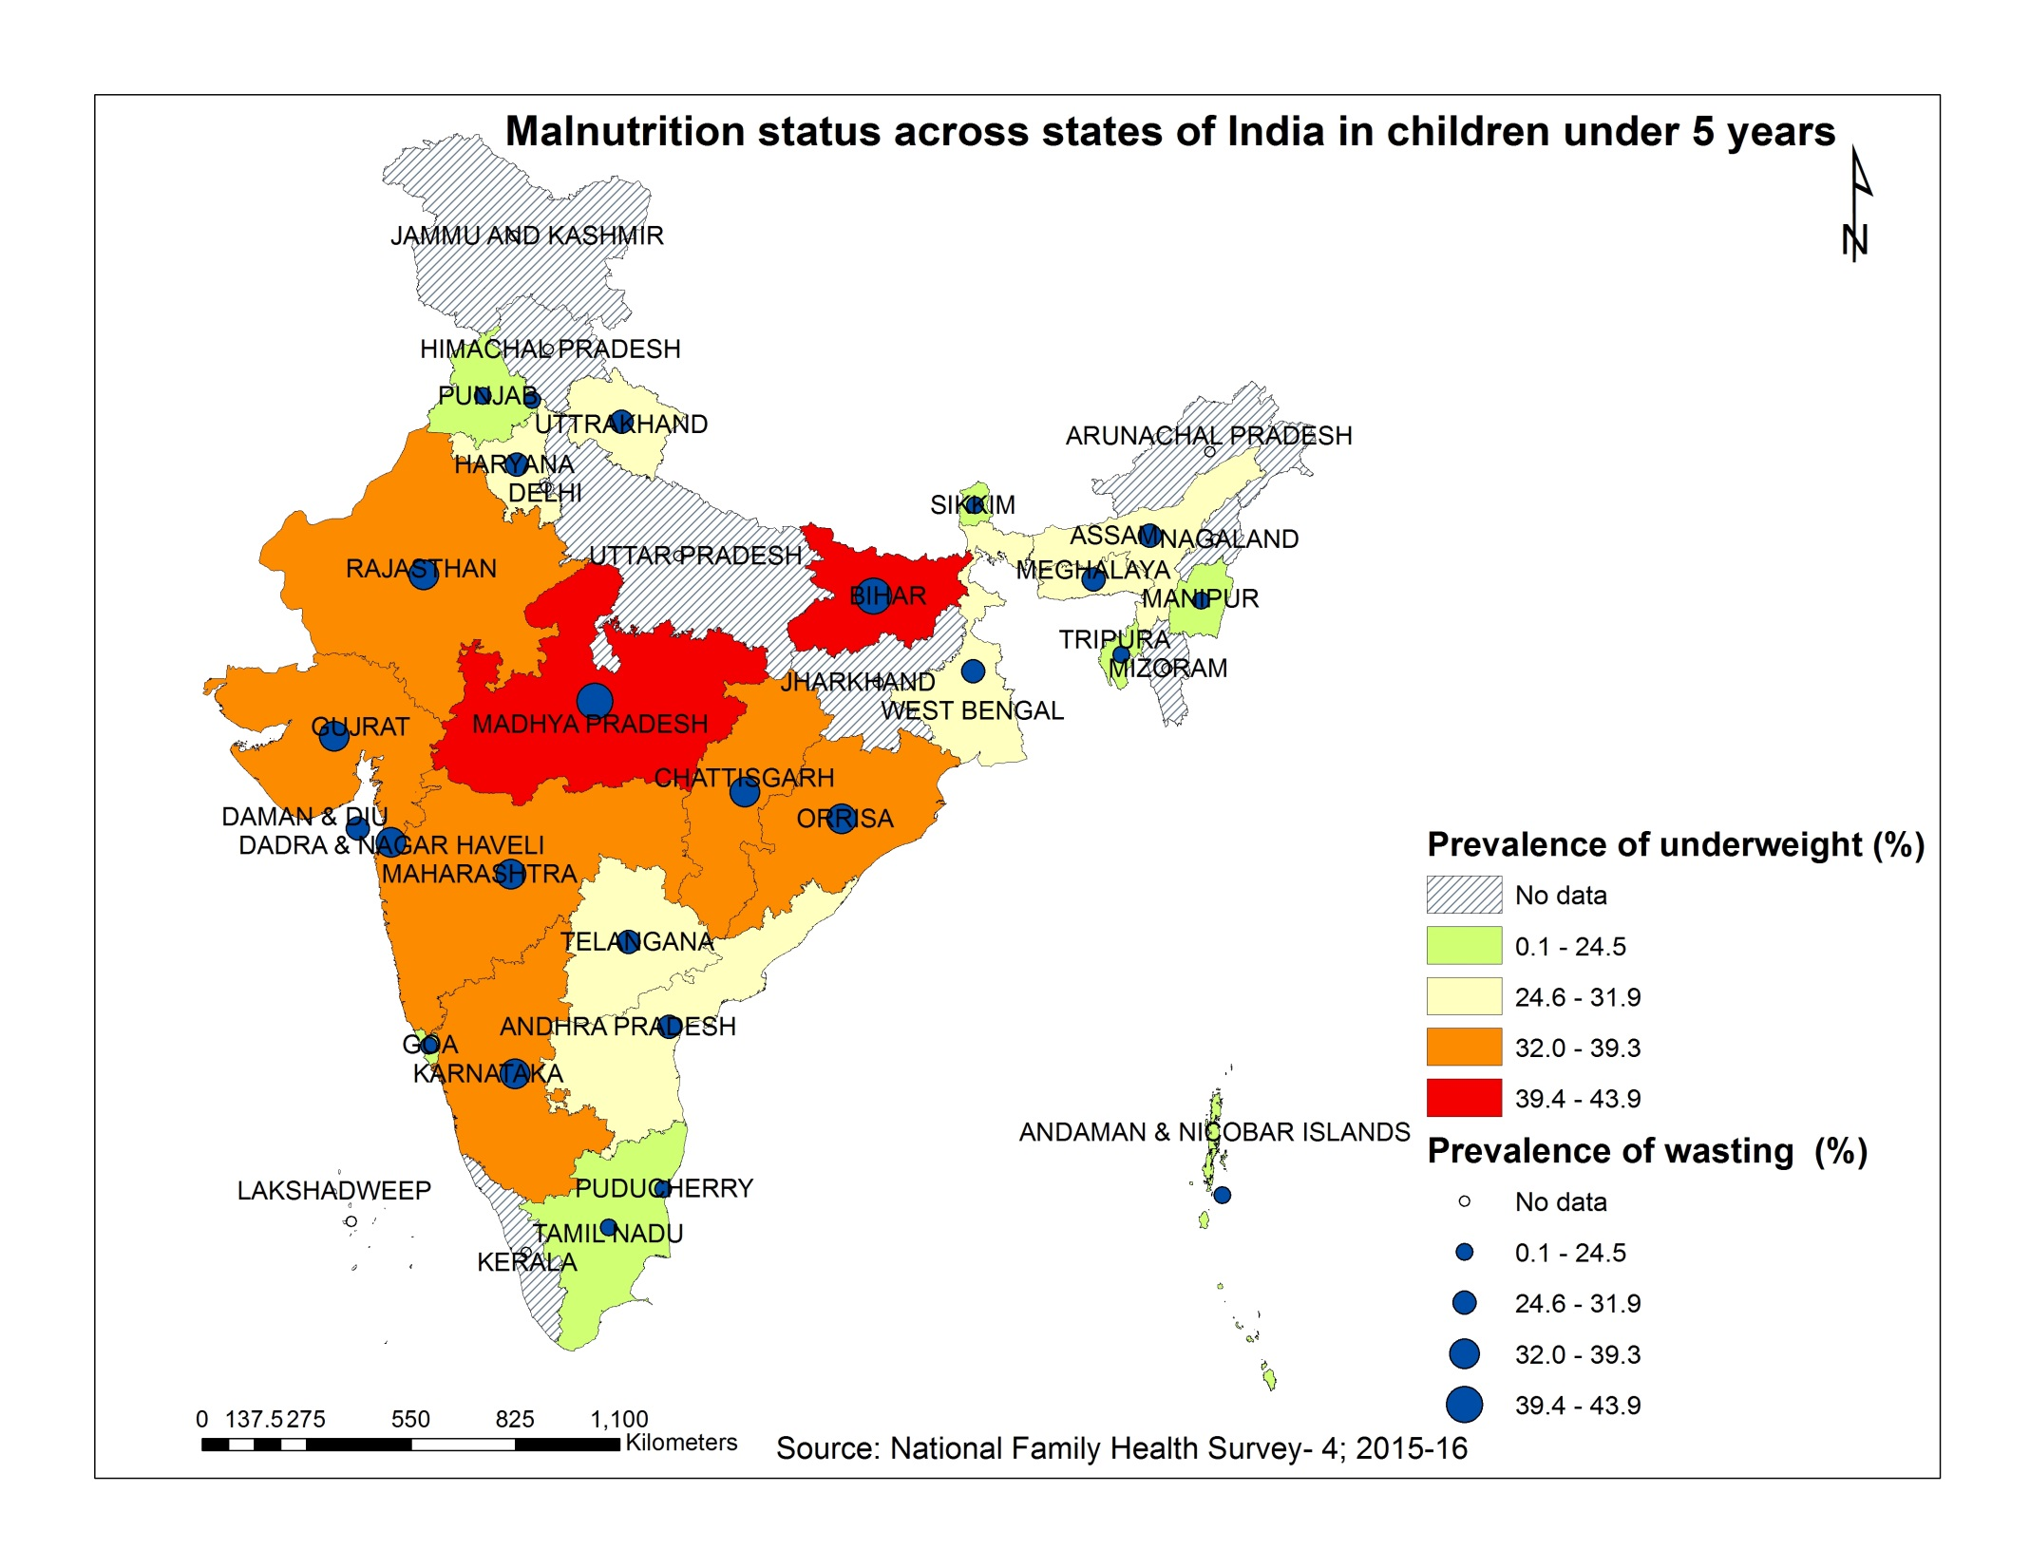
Notes:
IMD’s support for the agro-advisory, relief for health of the population. As this particularly, could reduce malnutrition which is more significant in some states than others, case in point, Bihar and Madhya Pradesh.
These states have been part of the ‘BIMARU’ or diseased (Bihar- Madhya Pradesh- Rajasthan– Uttar Pradesh) states since 1980s.
Nearly 40% Children from these two states are underweight (low weight-for-age) and show wasting (low weight-for-height).
Needless to say there are pockets of malnutrition in other states and urban areas as well.

Slide 13
UCHAI workshop : Opportunities identified
Ministry of Health &F amily Welfare (MOHFW), Department of Health & Family Welfare- Delhi, All India Institute of Medical Sciences (AIIMS), Indian Meteorological Department (IMD), National Health System Resource Centre (NHSRC), National Centre for Disease Control (NCDC), National Institute of Malaria Research (NIMR), Indian Council Of Medical Research (ICMR), National Institute of Urban Affairs (NIUA), Indian Institute of Public Administration (IIPA), TARU Ltd., The Energy and Resources Institute (TERI), Indian Institute of Public Health (IIPH), IIHMR, Public Health Foundation of India (PHFI),
Capacity building for Why and What action:
  multiple levels- national, state, district level
  information toolkit; website; videos; regional meetings
Inter-sectoral (IMD) partnerships – for short term forecasts for Vector Borne Diseases (VBDs) and heat-stress
Early warning systems ; Health advisories for VBDs and heat- stress,
Evidence building through Action/ Intervention research on climate related health risks for
Health Data Aspiration
  accessibility of health data (spatial & temporal) where available (VBDs- malaria, dengue, chikungunya), so that these data can be used for developing tools for predicting diseases;
  setting up mechanisms for data reporting shorter time intervals for diseases which are heat-related (heat-stress: stroke, exhaustion, cramps) or environmentally sensitive (chronic bronchitis/ COPD, asthma);
  data reporting to be comprehensive -include private hospitals
  data of deaths in the country coded (ICD 10)- for underlying cause of death, so that ‘mortality’ data can be used for attributing to climatic/ environmental factors .
Identified state level sources for budgetary support within the health system

Slide 14
Way Forward
Engage with National level policy makers; State level actions
  information toolkit; UCHAI website; videos; regional meetings
Work with the States to pilot
  Vulnerability assessment - targeted health advisories/ interventions for vulnerable groups
  Explore Early Warning Systems
  Tools to predict health effects and estimate health burden of various climate stressors should be developed
Mechanisms for improving accessibility and availability of both health and meteorology data
Create trans-disciplinary teams-Health, Environment, Meteorology Departments; across institutions and establishments for ensuring transformational and sustained health benefits

Slide 15
Health data: Capacity and Challenges
Disease | Data Sources | Periodicity | Spatial Scale
Vector- borne diseases Malaria, Dengue, Chikungunya, Lymphatic Filariasis, Kala- azar, Japanese encephalitis, Leishmaniasis | National Vector Borne Disease Control Programme (NVBDCP) & Integrated Disease Surveillance Project (IDSP) | Weekly | State level data District level data
Water- borne diseases Cholera, Typhoid, Hepatitis A, Leptospirosis, Acute diarrhoeal disease | Integrated Disease Surveillance Project (IDSP) | Weekly | State level data District level data
Nutrition Under 5 children: Undernutrition, wasting, stunting, anaemia; Adults (15- 49 years): overweight/ obesity, anaemia | National Family Health Survey (NFHS) | NFHS-1: 1992- 93 NFHS-2: 1998- 99 (after 4 years) NFHS-3: 2005- 06 (after 5 years) NFHS-4: 2015- 16 (after 8 years) | National level data State level data District level data (NFHS-4)
Notes:
Other surveys- DLHS, AHS
Survey
Variable
Design/Periodicity
Census of India
Demography, Economic Activity, Literacy & Education, Housing & Household Amenities
Ten years (2011), Household
District Level Household and Facility Survey (DLHS-4)
The household questionnaire: socio- economy, marriages, morbidities, and deaths
The Women questionnaire: maternal care, immunization and childcare, contraception, and fertility preferences, reproductive health including knowledge about HIV/AIDS.
The village questionnaire: availability of health, education, and other facilities in the village.
The health facility questionnaire: The human resources, infrastructure, and services.
Every five years (2012-13)
National Family Health Survey
(NFHS-4)
All women aged between 15 to 49 years and all men aged between 15 to 54 years. Questionnaire on family welfare: maternal and child health, family life education, safe injections, peri-natal mortality, adolescent reproductive health, high-risk sexual behaviour, tuberculosis, and malaria, testing the adult population for HIV.
Every six years (multi-round survey , representative sample of households throughout India. ) (2014-15)
Annual Health Survey (AHS)
Nutritional status,
Life style diseases : diabetes & hypertension and anemia in EAG states,
Clinical, Anthropometric & Bio-chemical (CAB) Survey.
Empowered Action Group (EAG) States: Bihar, Jharkhand, Madhya Pradesh, Chhattisgarh, Uttarakhand, Uttar Pradesh, Orissa and Rajasthan and Assam
9 States: high fertility and mortality
~ 48 percent of the total population, 4.32 million) 284 districts.

Slide 16
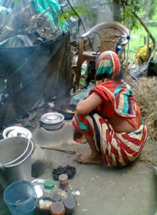
Household air pollution
Notes:
Other than high GDP states/ UT s most states have large number of households dependent on solid cooking fuel related air pollution (70- 80%in Bihar, West Bengal each)

